Slide 1


Rahaf Manwella Nabwani
03 Jully 2024

Slide 2

Outline
Executive Summary
Introduction
Methodology
Results
Conclusion
Appendix

Slide 3
Executive Summary
Summary of methodologies
- Data collection
- Data wrangling
- EDA with data visualization
- EDA with SQL
- Building an interactive map with Folium
- Building a Dashboard with Plotly Dash
- Predictive analysis (Classification)
Summary of all results
- Exploratory data analysis results
- Interactive analytics demo in screenshots
- Predictive analysis results

Slide 4
Introduction
Project background and context
We predicted if the Falcon 9 first stage will land successfully. SpaceX
advertises Falcon 9 rocket launches on its website, with a cost of 62
million dollars; other providers cost upward of 165 million dollars each,
much of the savings is because SpaceX can reuse the first stage.
Therefore, if we can determine if the first stage will land, we can
determine the cost of a launch. This information can be used if an
alternate company wants to bid against SpaceX for a rocket launch.
Problems you want to find answers
- What influences if the rocket will land successfully?
- The effect each relationship with certain rocket variables will impact in
determining the success rate of a successful landing.
- What conditions does SpaceX have to achieve to get the best results
and ensure the best rocket success landing rate.

Slide 5

Section 1

Slide 6
Executive Summary
Data collection methodology:
SpaceX Rest API
(Web Scrapping) from Wikipedia
Perform data wrangling
One Hot Encoding data fields for Machine Learning and dropping irrelevant columns
Perform exploratory data analysis (EDA) using visualization and SQL
Perform interactive visual analytics using Folium and Plotly Dash
Perform predictive analysis using classification models
LR, KNN, SVM, DT models have been built and evaluated for the best classifier
Methodology

Slide 7
Data Collection
The following datasets was collected:
• SpaceX launch data that is gathered from the SpaceX REST API.
• This API will give us data about launches, including information about the rocket used, payload delivered, launch specifications, landing specifications, and landing outcome.
• The SpaceX REST API endpoints, or URL, starts with api.spacexdata.com/v4/.
• Another popular data source for obtaining Falcon 9 Launch data is web scraping Wikipedia using BeautifulSoup.

Slide 8
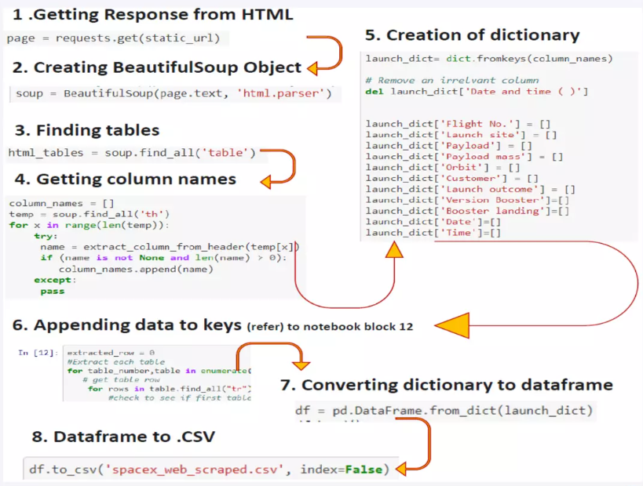
Data Collection - Scraping
Web Scraping from
Wikipedia

Slide 9
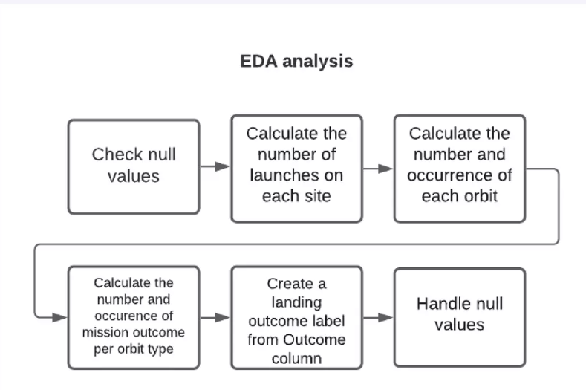
Data Wrangling

Slide 10
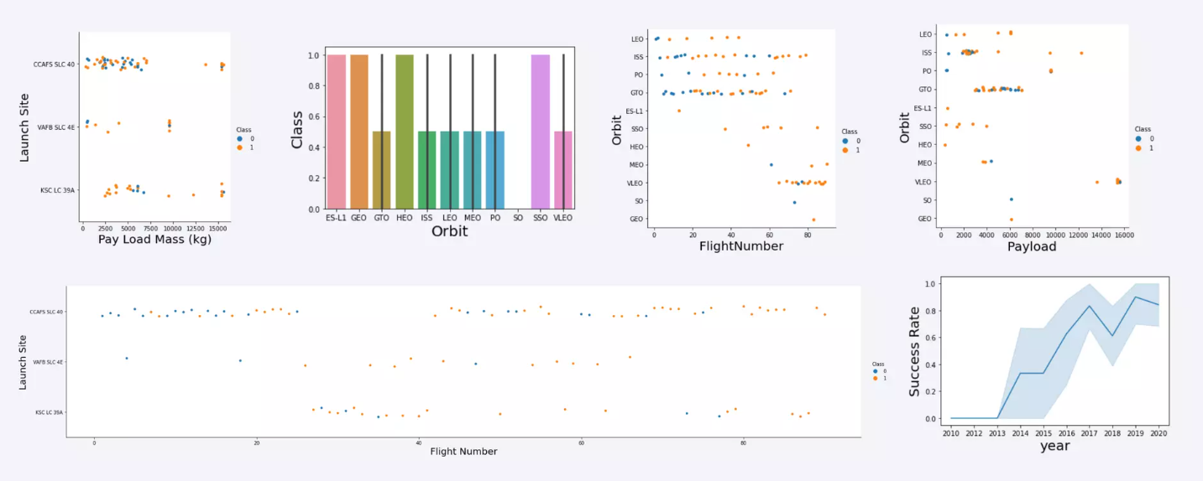
EDA with Data Visualization

Slide 11
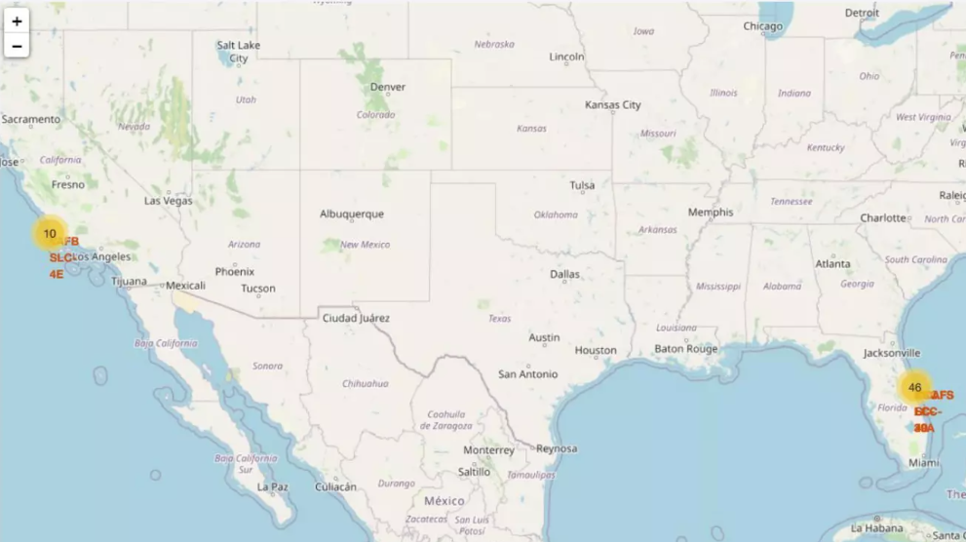
Build an Interactive Map with Folium

Slide 12
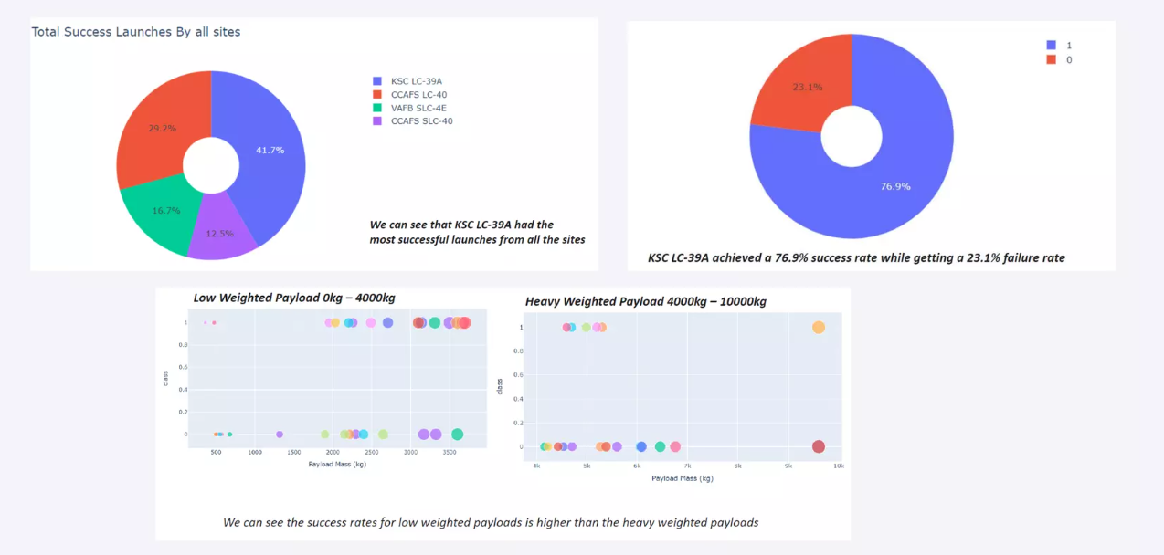
Build a Dashboard with Plotly Dash

Slide 13
Results
• The SVM, KNN, and Logistic Regression models are the best in terms of
prediction accuracy for this dataset.
• Low weighted payloads perform better than the heavier payloads.
• The success rates for SpaceX launches is directly proportional time in years they
will eventually perfect the launches.
• KSC LC 39A had the most successful launches from all the sites.
• Orbit GEO,HEO,SSO,ES L1 has the best Success Rate.

Slide 14

Section 2

Slide 15
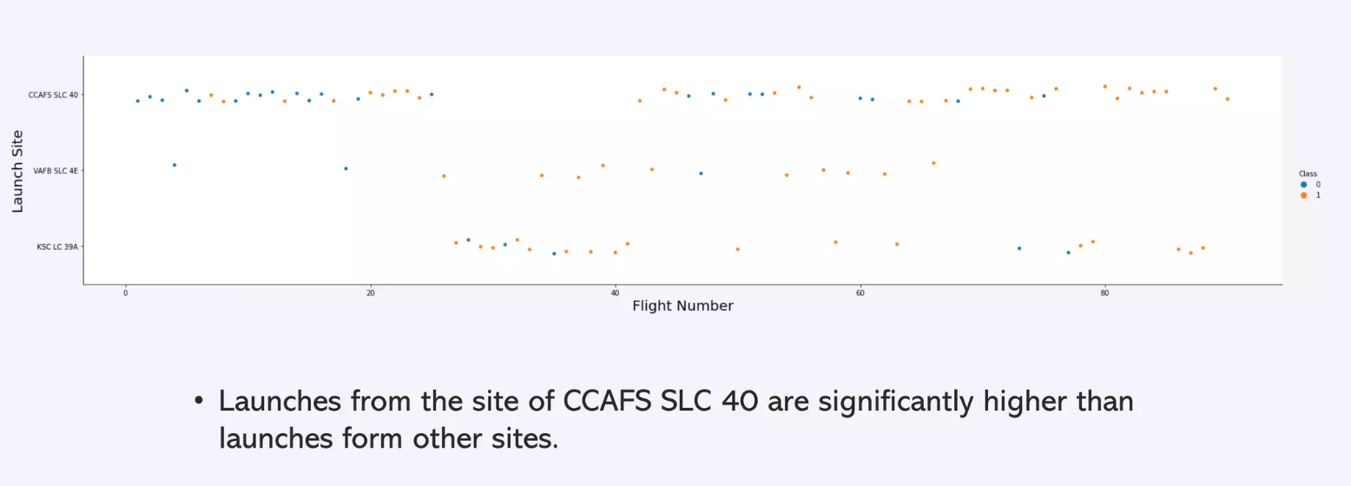
Flight Number vs. Launch Site

Slide 16
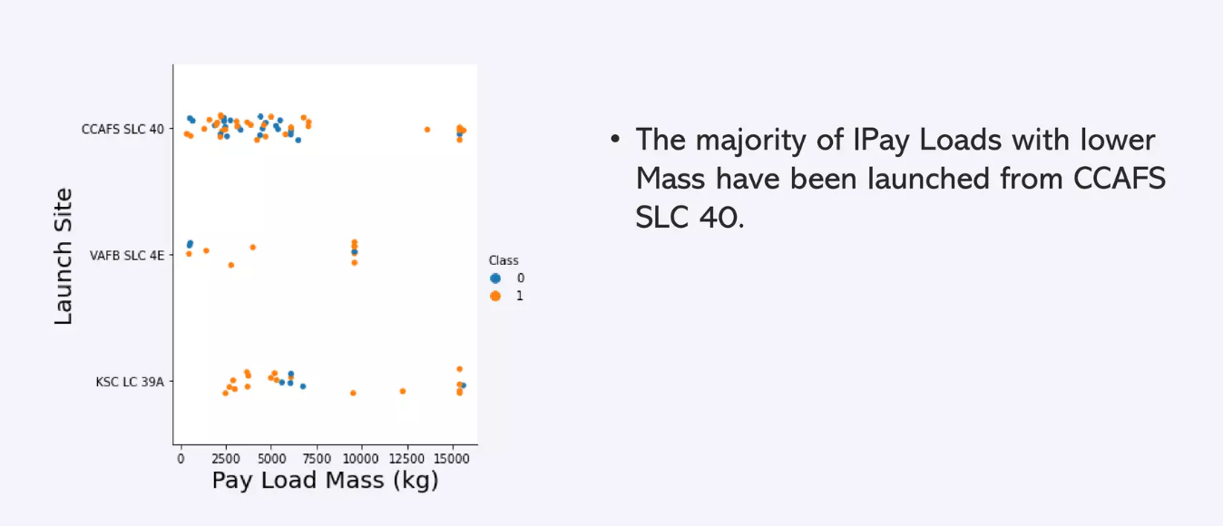
Payload vs. Launch Site

Slide 17
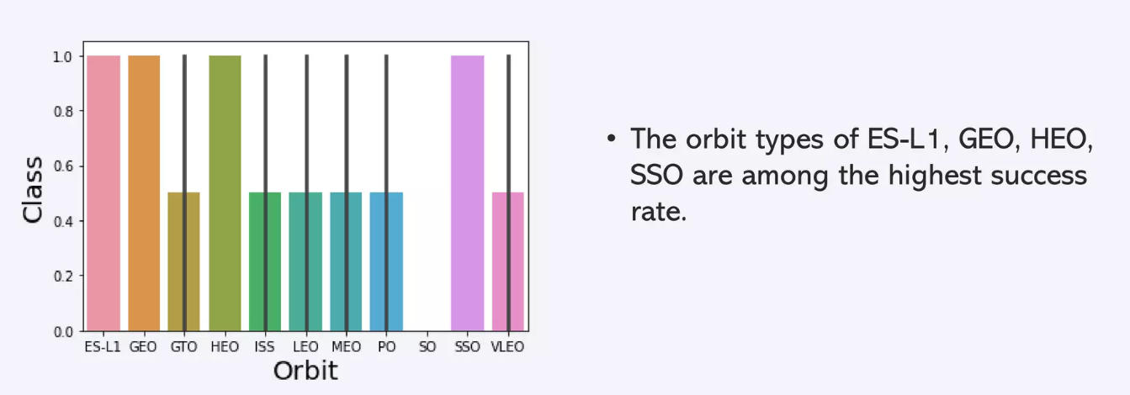
Success Rate vs. Orbit Type

Slide 18
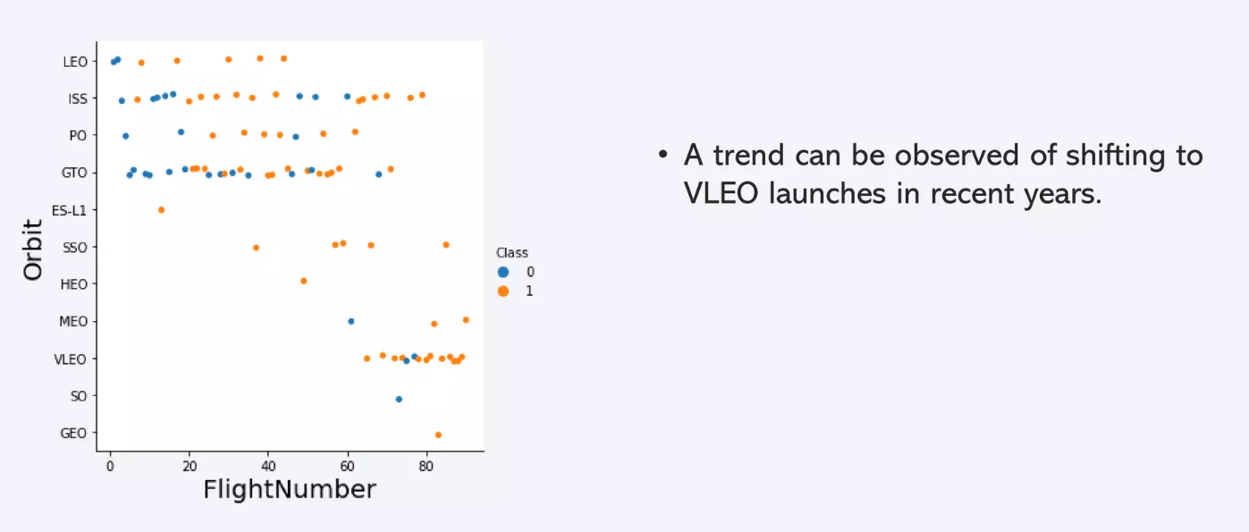
Flight Number vs. Orbit Type

Slide 19
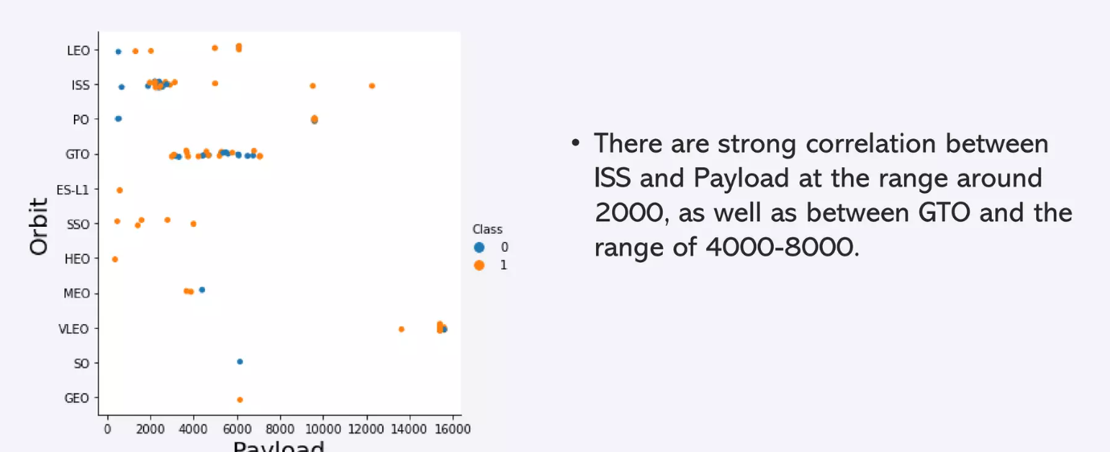
Payload vs. Orbit Type

Slide 20
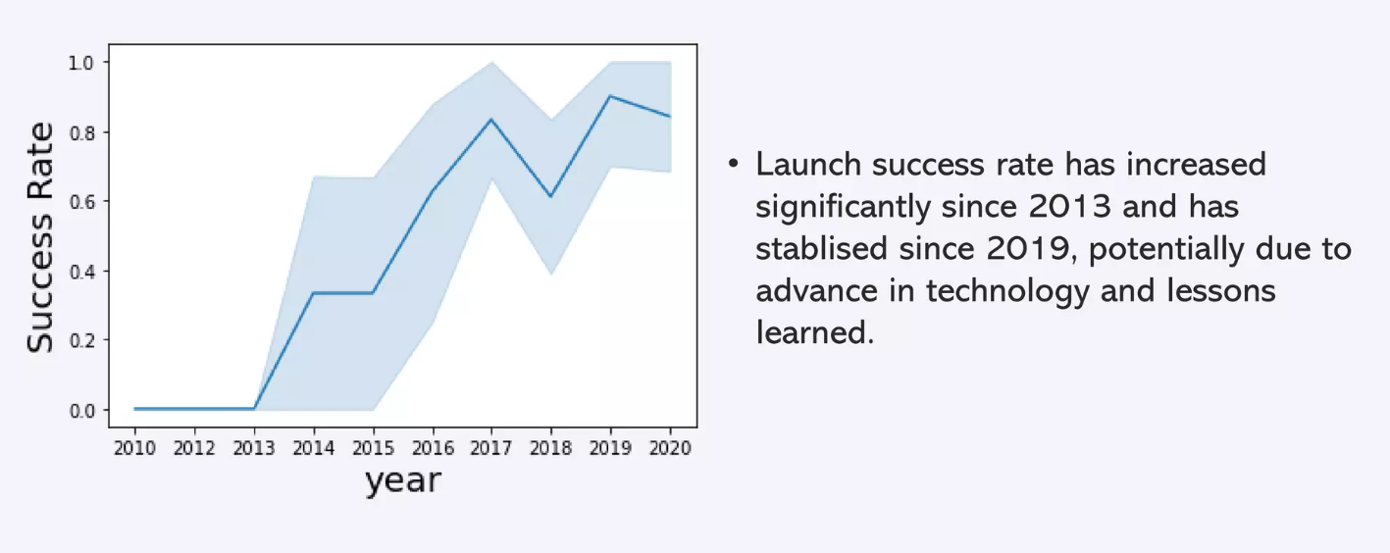
Launch Success Yearly Trend

Slide 21
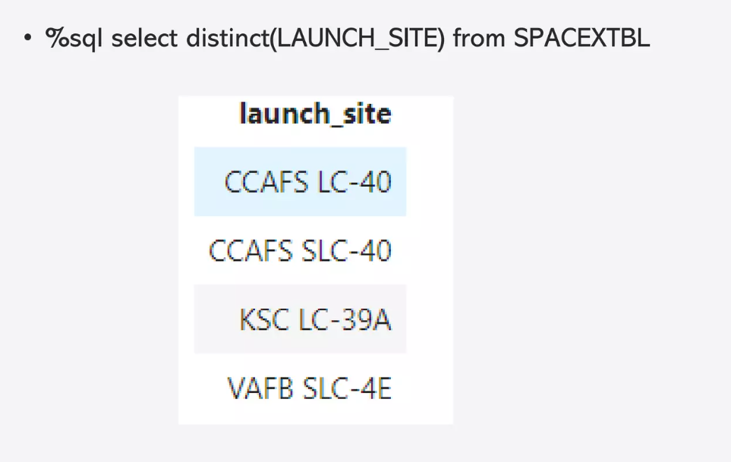
All Launch Site Names

Slide 22
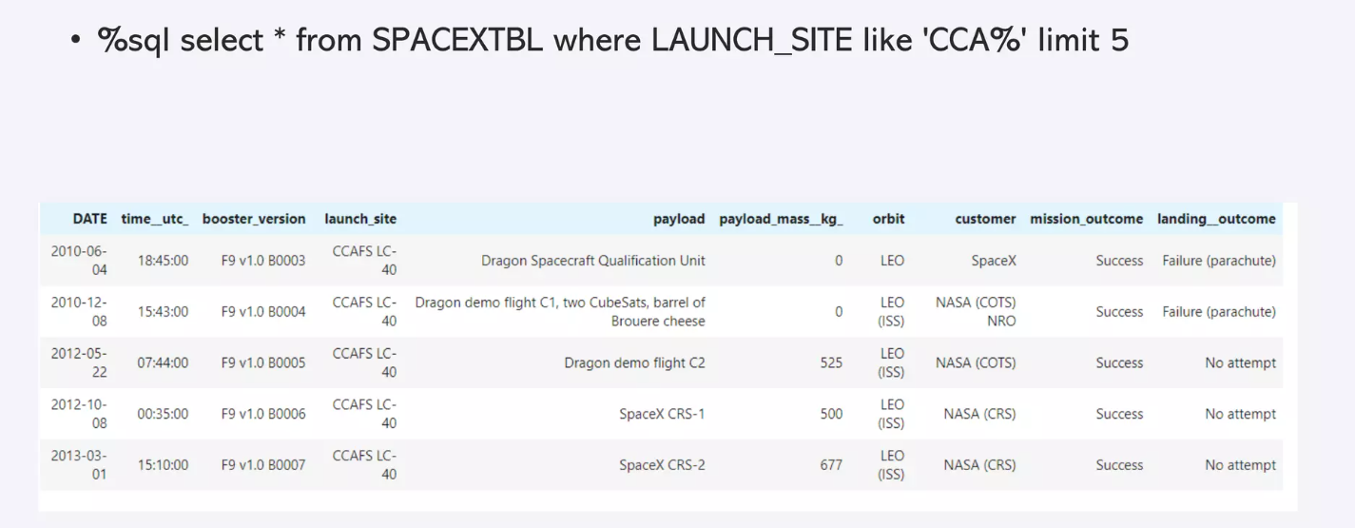
Launch Site Names Begin with 'CCA'

Slide 23
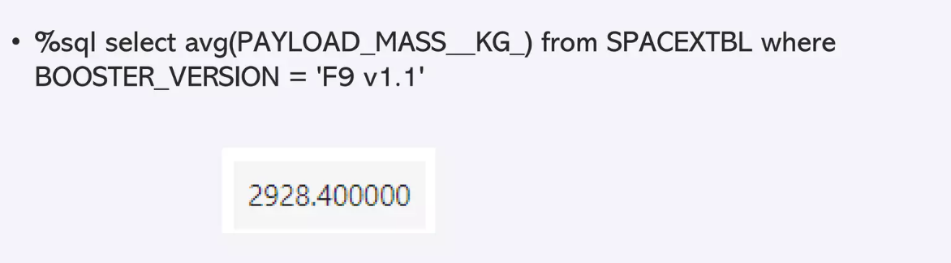
Average Payload Mass by F9 v1.1

Slide 24
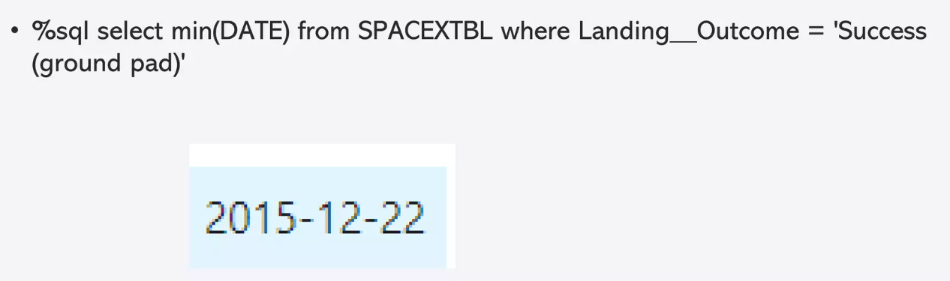
First Successful Ground Landing Date

Slide 25
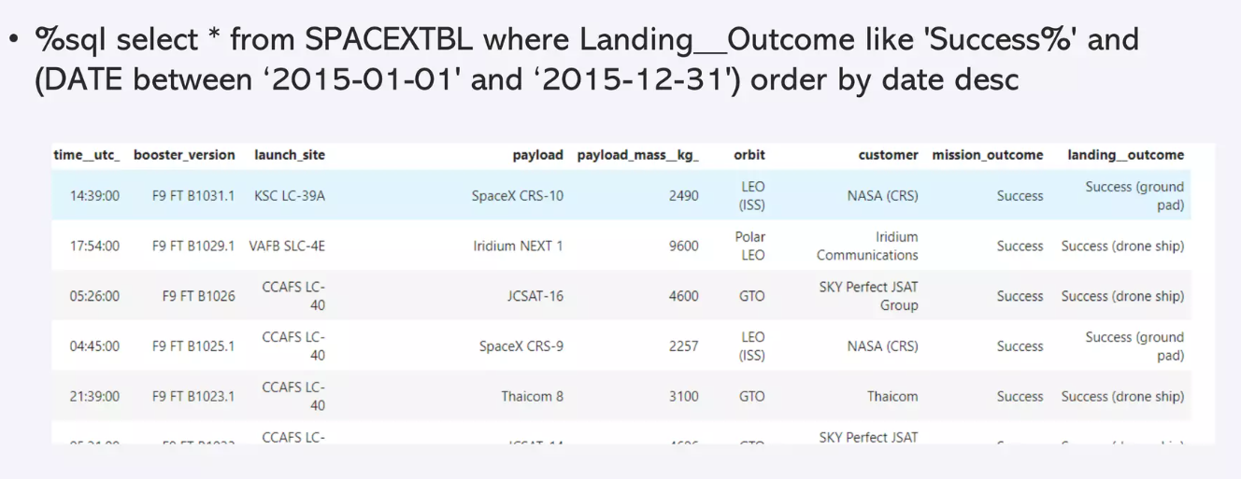
2015 Launch Records

Slide 26
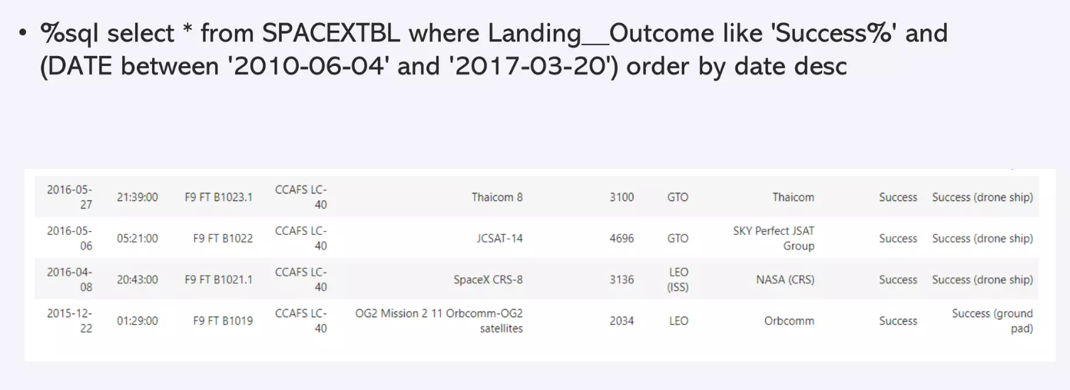
Rank Landing Outcomes Between 2010-06-04 and 2017-03-20

Slide 27

Section 3

Slide 28
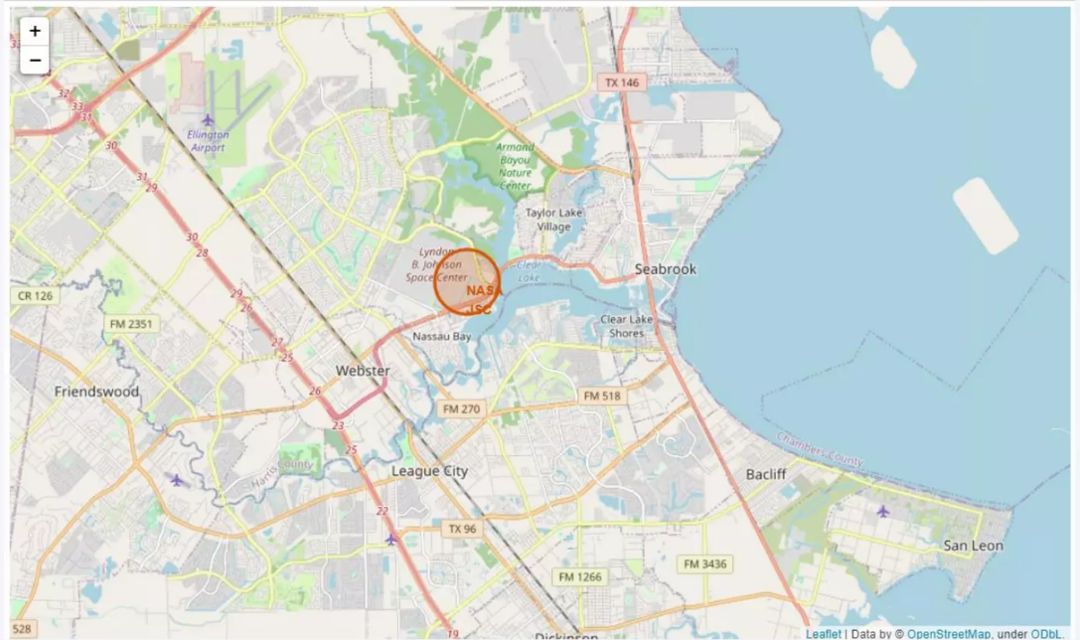
All launch sites marked on a map

Slide 29

Section 4

Slide 30
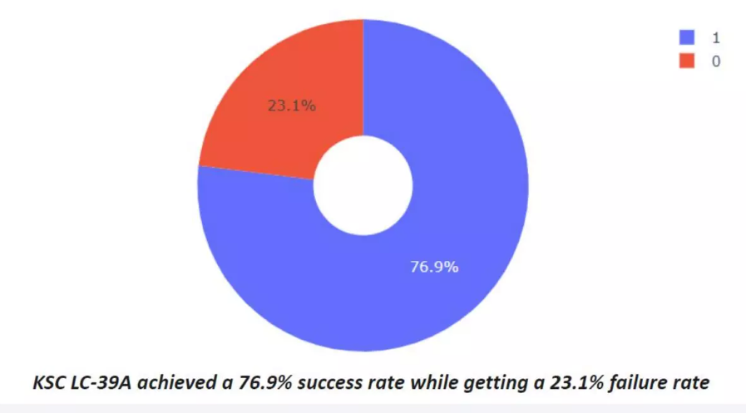
Success rate by site

Slide 31
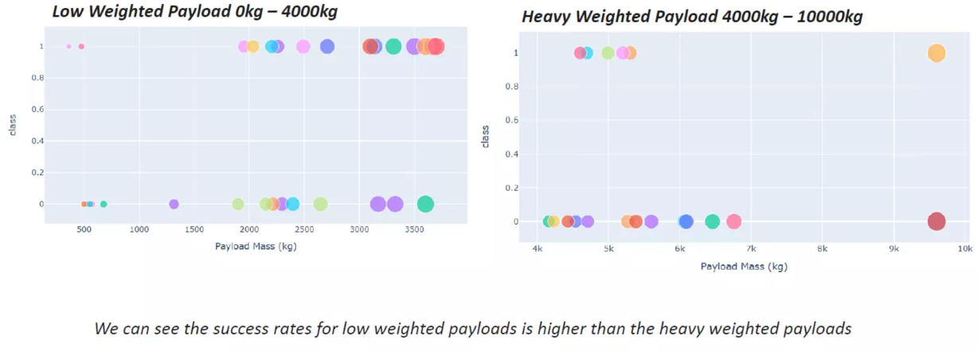
Payload vs launch outcome

Slide 32

Section 5

Slide 33
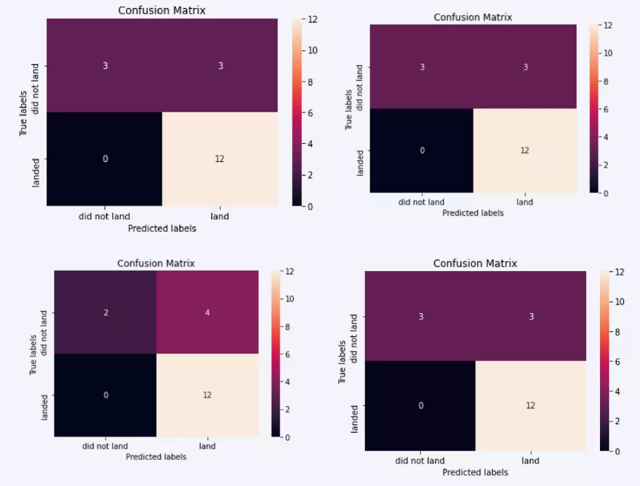
Confusion Matrix

Slide 34
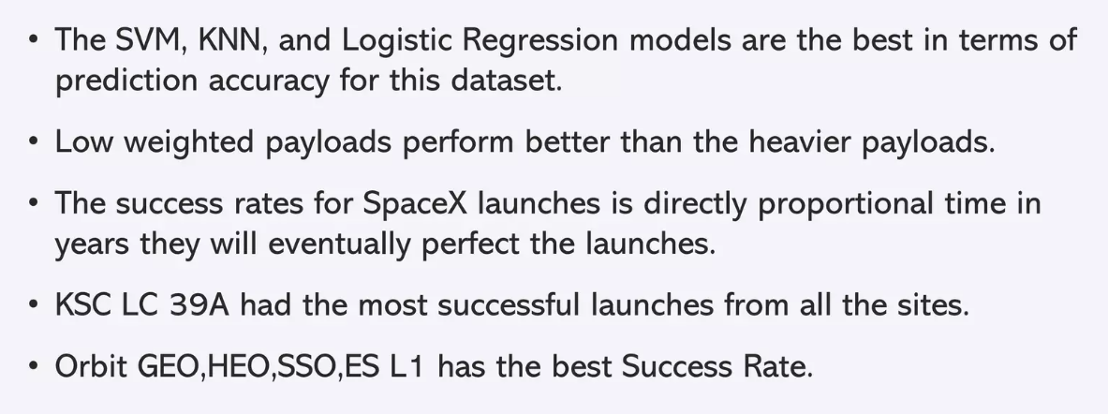
Conclusions

Slide 35


